Slide 1

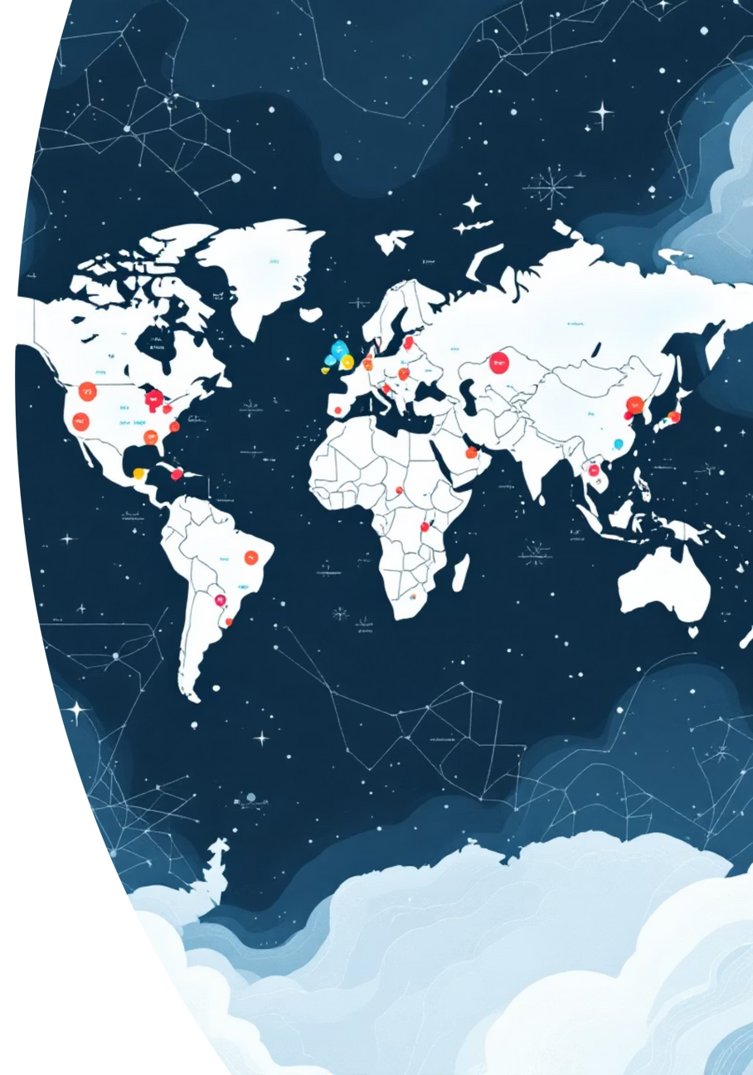

AEROSENSE: World Air Quality Analysis & Prediction
(Combining Data Analytics and Machine Learning with Streamlit)
Presenter: Hardik Khambhaliya
Project Focus: Developing an interactive web application to analyze, visualize, and predict global Air Quality Index (AQI) categories.
Key Takeaway (Hook): This project translates complex environmental data into a predictive, user-friendly tool, providing actionable insights into global air quality trends.
Notes:
‹#›

Slide 2

Air Quality: A Critical Global Challenge
The Challenge:
The Solution: AEROSENSE
  Air pollution (PM2.5, NO2​, CO, SO2​, O3​) is a major public health concern.
  Platform: Interactive web application built with Python's Streamlit.
  Data is often fragmented and complex, making trend analysis difficult for the public and policymakers.
  Goal: Provide a single, accessible platform for data exploration, visualization, and AI-powered prediction of AQI categories.
  Core Function: Convert raw pollutant data into actionable insights and forecasts.
Notes:
‹#›

Slide 3

Interactive Data Exploration and Visualization
Tools Used: Python (Pandas, Matplotlib, Streamlit)
Key Interactive Modules :
01
02
Country-wise Analysis
Aggregation Control
User selects a country and instantly views air quality trends.
User chooses the Average, Sum, or Median pollutant values for comparison.
03
04
Visualization
Critical Feature
Dynamic bar charts display pollutant levels (PM2.5, NO2​, SO2​, O3​, CO).
Plots utilize a Logarithmic Scale (plt.yscale("log")) to effectively compare pollutants with widely varying concentration levels.
Notes:
‹#›

Slide 4




Predictive Insights: Forecasting AQI Categories
Model: Random Forest Classifier (A classification algorithm)
Goal: Predict the final Air Quality Category (e.g., Good, Moderate, Unhealthy) based on input pollutant values.
The Machine Learning Pipeline:
Data Preprocessing
Used Label Encoding (LabelEncoder) to transform the categorical target variable (AQI Category) into a numerical format for the model.
Model Training
The classifier is trained on historical data.
Prediction Module
Allows a user to input pollutant type and value, and the model instantly outputs the corresponding predicted AQI category.
Justification
Random Forest is robust and effective at capturing the non-linear relationship between multiple pollutants and the resulting air quality category.
Notes:
‹#›

Slide 5
End-to-End Data Science Proficiency
Phase
Technical Skill
Tool/Library
Data Acquisition
API Integration (ISRO, Crypto, COVID) & Data Wrangling
Python (requests, Pandas)
Data Analysis
Conditional Data Fetching, Result Analysis (CSV handling)
Pandas, NumPy
Visualization
Data Storytelling via Charts (Bar, Line, Pie) and Dashboards
Matplotlib, Power BI
Machine Learning
Supervised Learning, Model Training & Evaluation (Random Forest, Master's Prediction)
Scikit-learn
Web Application
Building an Interactive, Multi-module User Interface
Streamlit
Notes:
‹#›

Slide 6

Conclusion: Bridging Theory to Application
Summary of Achievement:
Future Scope (Next Steps):
  Successfully implemented a functional, interactive data application (AEROSENSE).
  Integrate Time Series Forecasting (e.g., ARIMA or RNN) to predict future pollutant concentration levels over time.
  Demonstrated proficiency across the entire data science pipeline: Acquisition → Cleaning → Visualization → Prediction.
  Expand the model with additional features like weather data and seasonal variations for enhanced prediction accuracy.
  The project serves as a solid platform for applying data analytics and machine learning concepts to real-world scenarios.
  Deploy the application for public access and real-time data streaming.
Notes:
‹#›

